Slide 1
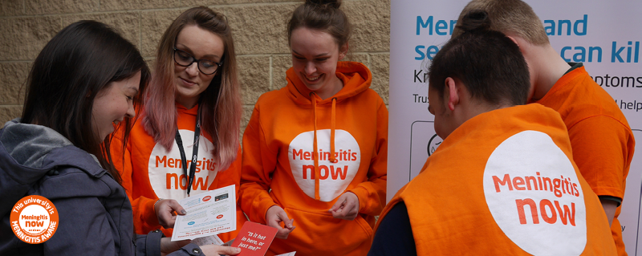
Meningitis information for universities

Slide 2
Introduction
Thank you for your interest in learning more about meningitis and septicaemia and ensuring that your university is Meningitis Aware.
The information in this presentation will give you an overview of meningitis and septicaemia. Being aware of the signs and symptoms and seeking urgent medical advice, can - and does - save lives.
If you have any specific disease questions, not answered here, please contact our helpline: 0808 80 10 388 or email: helpline@meningitisnow.org

Slide 3
Why is meningitis a concern?
Bacterial meningitis:
  is a life-threatening infectious disease
  can affect anyone of any age, however university students have a higher risk
  can cause long-term after-effects
  vaccines do not exist to protect against all causes of meningitis and no vaccine 100% effective
  early signs and symptoms can appear similar to 'flu' or a stomach bug

Slide 4




MENINGITIS CAN AFFECT ANYONE
It can strike quickly and kill within hours

Slide 5
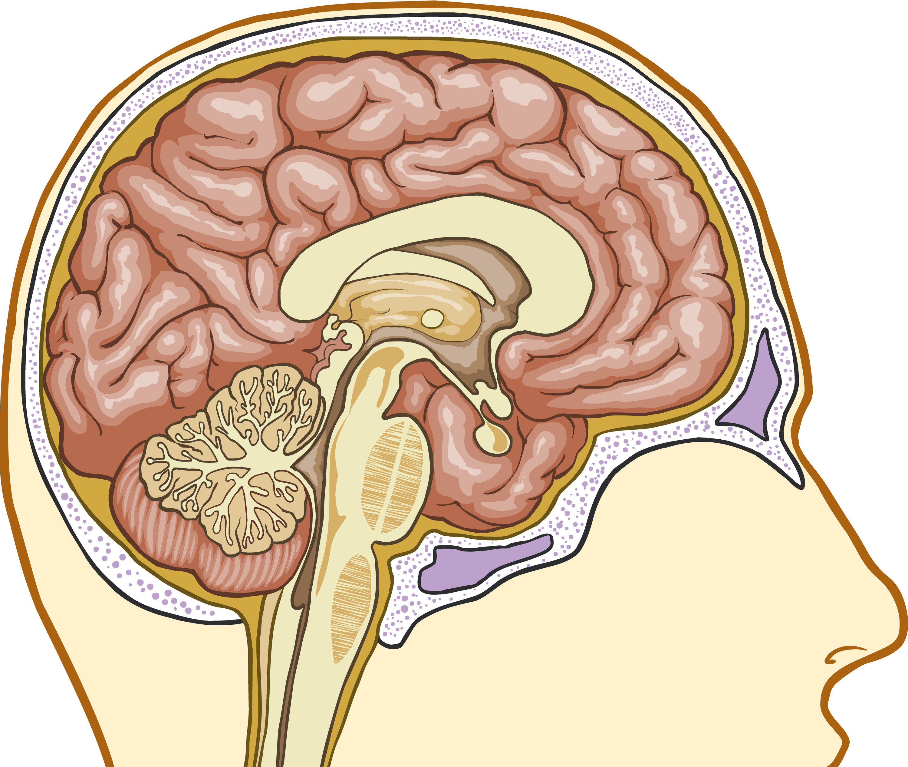
What is Meningitis?
Inflammation (swelling) of the
layers that surround the
brain and spinal cord
Meningitis is usually caused by
a viral or bacterial infection
Some bacteria that cause
meningitis can also cause
septicaemia (blood
poisoning)
SKULL
MENINGES
BRAIN
Notes:
Background information
Let me tell you a little about the disease.
Meningitis is the inflammation or swelling of the membranes (called the meninges) which surround and protect the brain and spinal cord
Meningitis is usually caused by an infection, either from viruses or bacteria
Some people will have both meningitis and septicaemia at the same time.

Slide 6
Meningococcal disease
A term used to describe two major illnesses – meningitis and septicaemia (blood poisoning) caused by meningococcal bacteria.
Meningococcal disease is the most common cause of bacterial meningitis in the UK
There are five main groups of meningococcal bacteria that commonly cause disease. They are called - MenA, MenB, MenC, MenW, MenY
MenB causes the majority of the disease in the UK

Slide 7
Recognising the signs and symptoms
Symptoms can appear in any order. Some may not appear at all
Early signs and symptoms can be mistaken for flu, a hang over or a tummy upset.
Someone with meningitis or septicaemia can get a lot worse very quickly. Keep checking them

Slide 8

Signs and Symptoms
Knowing the signs and symptoms to look out for and the action to take, saves lives…
Notes:
Background Information
After the video, stress the following messages
Many people have heard of a rash associated with meningitis. DO NOT WAIT FOR A RASH TO APPEAR, Not everyone gets a rash, and it can be a late sign.
If someone is ill and getting worse seek urgent medical attention.
Look after each other, if you or a friend is unwell, tell someone, keep a watch on each other.

Slide 9
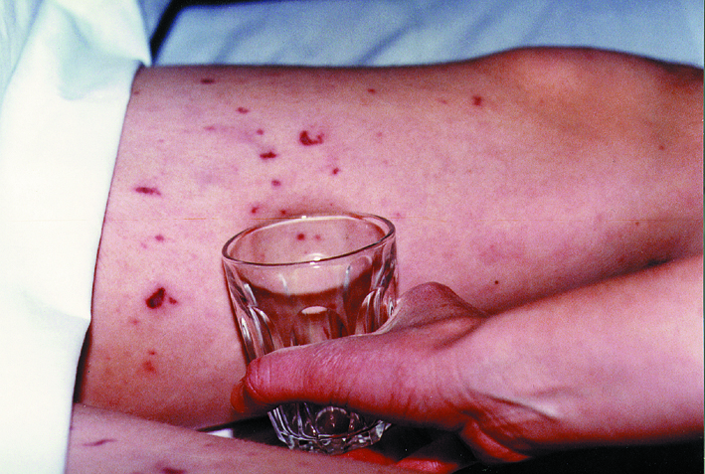
Septicaemia and the ‘glass test’
People with septicaemia may develop a rash of tiny red ‘pin pricks’ which can develop into purple bruising
This rash does not fade under pressure; do the ‘glass test’
Fever with spots/rash that do not fade under pressure is a medical emergency
Do not wait for a rash. If someone is ill and getting worse, get medical help immediately
On dark skin the spots/rash can be more difficult to see. Do not wait for the rash. Be aware of all the signs and symptoms

Slide 10
Getting medical help
If you are concerned it could be meningitis or septicaemia you can:
Call NHS 111 or your GP
In an emergency you can:
Dial 999 for an ambulance
Go to your nearest accident and emergency department
Describe the symptoms and say you think it could be meningitis or septicaemia.
Early diagnosis can be difficult. If you have had advice and are still concerned, get medical help again
Trust your instincts – get medical help immediately

Slide 11
What is the risk to others following a case in a university?
Meningitis is not highly contagious – most cases happen in isolation, with no further cases occurring. There is a small risk to those who have had close prolonged contact with the person who has become ill
Prolonged close contact means those living in the same household or sharing a sub-unit (e.g. shared kitchen/bathroom facilities) as the person who has become ill, along with any intimate kissing partners
When a case occurs, the local public health team are notified (by the doctor diagnosing the illness). They will liaise with the university and identify any close contacts to offer advice and guidance.
There is no reason to prevent students attending university following a case.

Slide 12
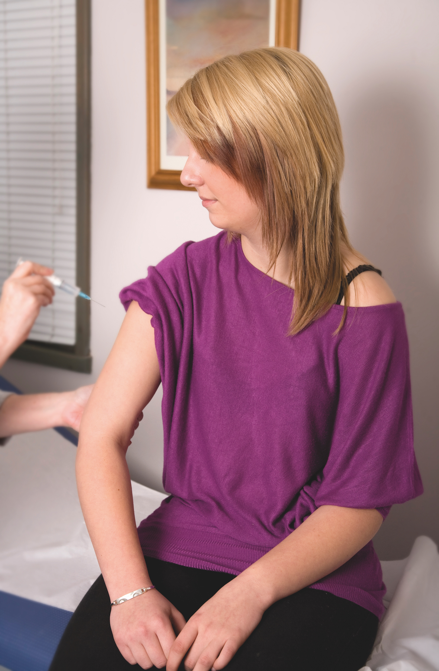
Meningitis Vaccines
Young people are offered the MenACWY vaccine around the age of 14yr.
This vaccine is very effective in protecting against 4 different strains of meningococcal disease (MenA, C, W and Y) it will not protect against MenB.
Any student who has missed this vaccine remains eligible until the age of 25yr and should be encouraged to seek vaccination from their GP/university health centre.
The MenACWY vaccine will not protect against all causes of meningitis, it remains vital to be aware of the signs of meningitis and seek urgent medical advice if concerned.
Notes:
Background Information
The MenACWY vaccine is given at school. This vaccine will continue to protect students after they have left school and go to university/college (no need for a booster)
This vaccine will not protect them against all causes of meningitis (no vaccine will)
Other meningitis vaccines are provided by the NHS and given to babies and infants
If someone is unsure which vaccine they need or have had, always direct them to their GP surgery.
If someone is asking for general information about meningitis vaccines, you can direct them to our website or helpline for more information.

Slide 13
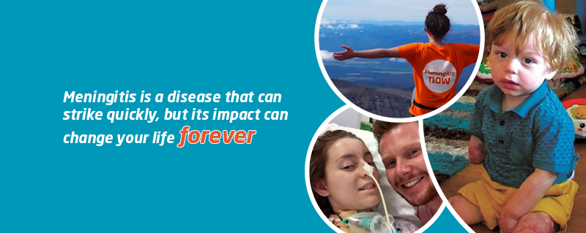
Outcomes of meningitis

Slide 14
Outcomes of meningitis
Full Recovery
Many will make a good recovery without lasting after-effects, however recover can take time
After-effects
Wide range of after-effects
Vary from mild to those causing severe disability and include brain injury, limb loss, hearing or sight loss.
“Hidden” or less obvious after-effects can include headaches, memory loss, concentration issues, fatigue and emotional difficulties
Death
Around 10% of people who contract bacterial meningitis will sadly die

Slide 15
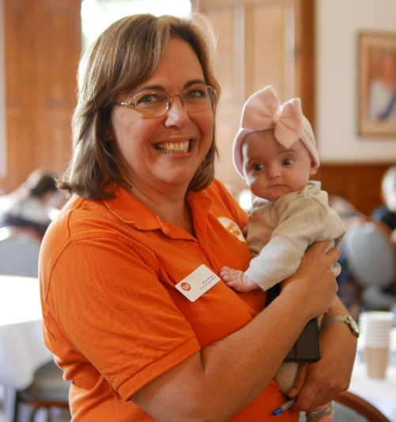

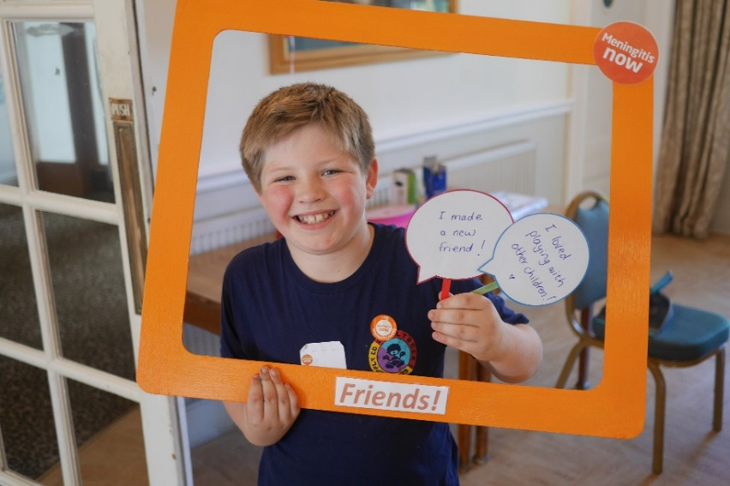
Support from Meningitis Now
We offer a range of free awareness materials, printed and digital for universities
Our volunteers can help with awareness raising by attending events such as freshers fairs and providing awareness materials
Our support team provides support to anyone who has been impacted by meningitis in the UK, contact 0808 80 10 388 or helpline@meningitisnow.org for more information
Notes:
If you know of anyone who could benefit from support, please pass on our details

Slide 16
Summary
Meningitis can affect anyone at any time – however, university students have a higher risk
Knowing the signs and symptoms and seeking urgent medical
help can help save lives
Many are left with serious and disabling after-effects that require ongoing care and support
Meningitis Now offers information, help and support to anyone affected by meningitis

Slide 17


