Slide 1
Meningitis information for universities

Slide 2
Introduction
Thank you for your interest in learning more about meningitis and septicaemia and gaining our Meningitis Aware Recognition Mark.
The information in the presentation will give you an overview of meningitis and septicaemia. Being aware of the signs and symptoms and seeking urgent medical advice, can - and does - save lives.
If you have any specific disease questions, not answered here, please contact our helpline: 0808 80 10 388 or email: helpline@meningitisnow.org

Slide 3
Why is meningitis a cause for concern with students
Bacterial meningitis is a life-threatening infectious disease
It can affect anyone at any time, however university students have a higher risk due to living in student accommodation and extensive ‘social’ contact
Vaccines exist to protect against some causes of meningitis and septicaemia, however there is no vaccine to protect against all causes
In the UK every university could experience at least one case of meningitis or meningococcal disease (meningitis and septicaemia) amongst its students within the first term

Slide 4
MENINGITIS CAN AFFECT ANYONE
It can strike quickly and kill within hours

Slide 5
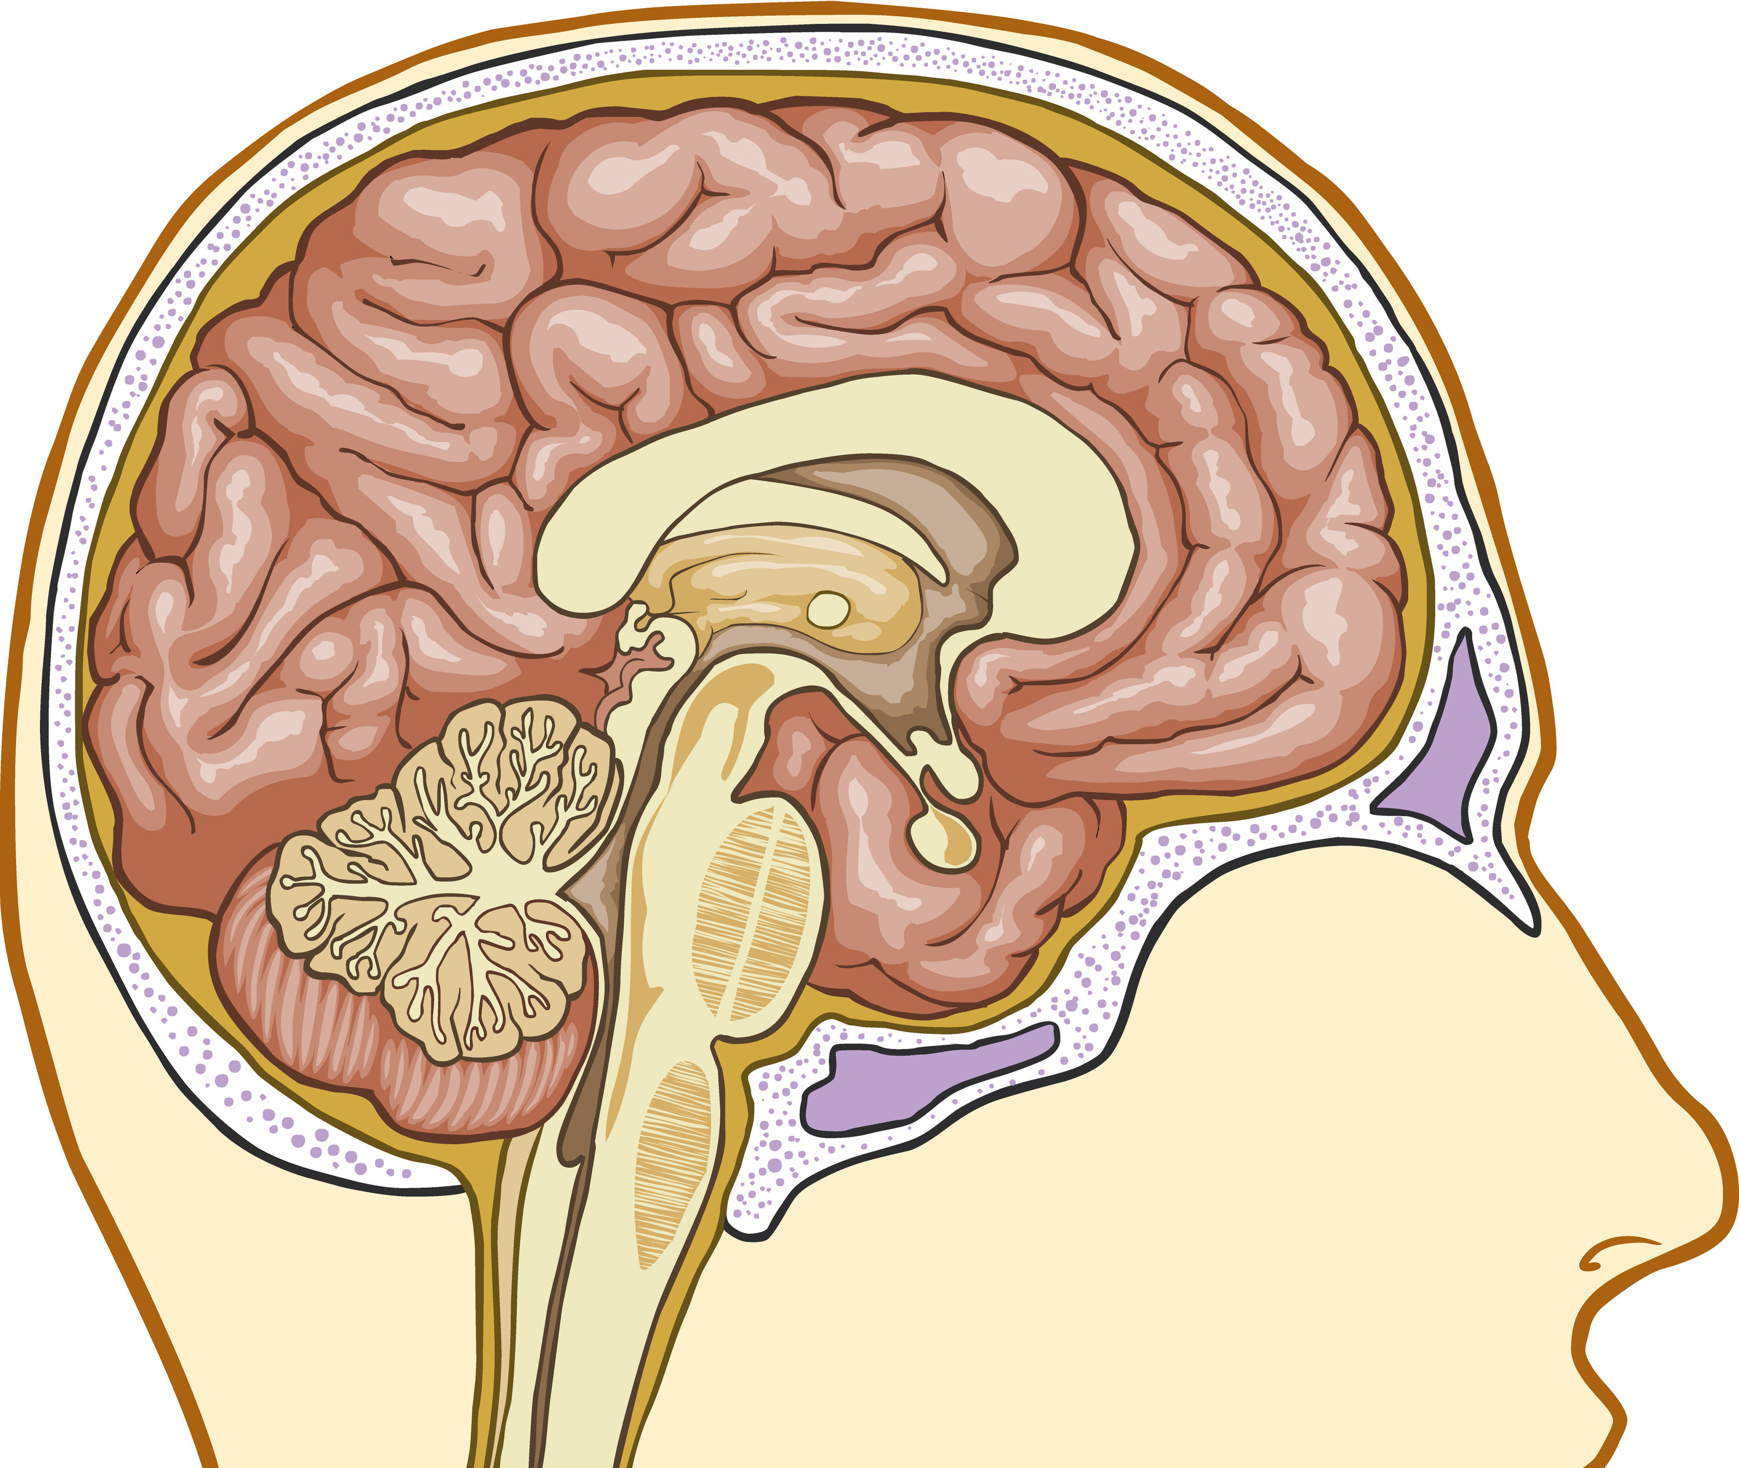
What is meningitis?
Inflammation of the protective
layers (meninges) that surround
the brain and part of the spinal
cord
Skull
Meninges
Brain
Top of the spinal cord
What is septicaemia?
Some bacteria that cause meningitis can also cause septicaemia (blood poisoning). Septicaemia is a cause of sepsis - a life-threatening condition that arises when the body’s response to an infection injures its own tissues and organs.

Slide 6
What causes meningitis?
Meningitis is most commonly caused by bacteria or viruses
Bacterial
Viral
Meningococcal (most common cause)
Pneumococcal
TB
Group B streptococcal
E. coli
Hib
Enteroviruses
Herpes Simplex
Mumps (now rare)

Slide 7
Viral and bacterial meningitis
Viral meningitis
Bacterial meningitis
Rarely life-threatening
Life-threatening
Rapid admission to hospital, treated with antibiotics
Pain relief, fluids and rest
Not considered to be contagious
Can be contagious and may require public health action
After-effects include deafness, acquired brain injury and limb loss (septicaemia)
After-effects include headaches, tiredness and memory loss

Slide 8
Meningococcal disease
A term used to describe two major illnesses – meningitis and septicaemia (blood poisoning) caused by meningococcal bacteria
Meningococcal disease is the most common cause of bacterial meningitis in the UK
There are five main groups of meningococcal bacteria that commonly cause disease - MenA, MenB, MenC, MenW, MenY
MenB causes the majority of the disease in the UK

Slide 9
Recognising the signs and symptoms
Meningitis and septicaemia often happen together. Be aware of all the signs and symptoms
Symptoms can appear in any order. Some may not appear at all
Someone with meningitis or septicaemia can get a lot worse very quickly. Keep checking them

Slide 10
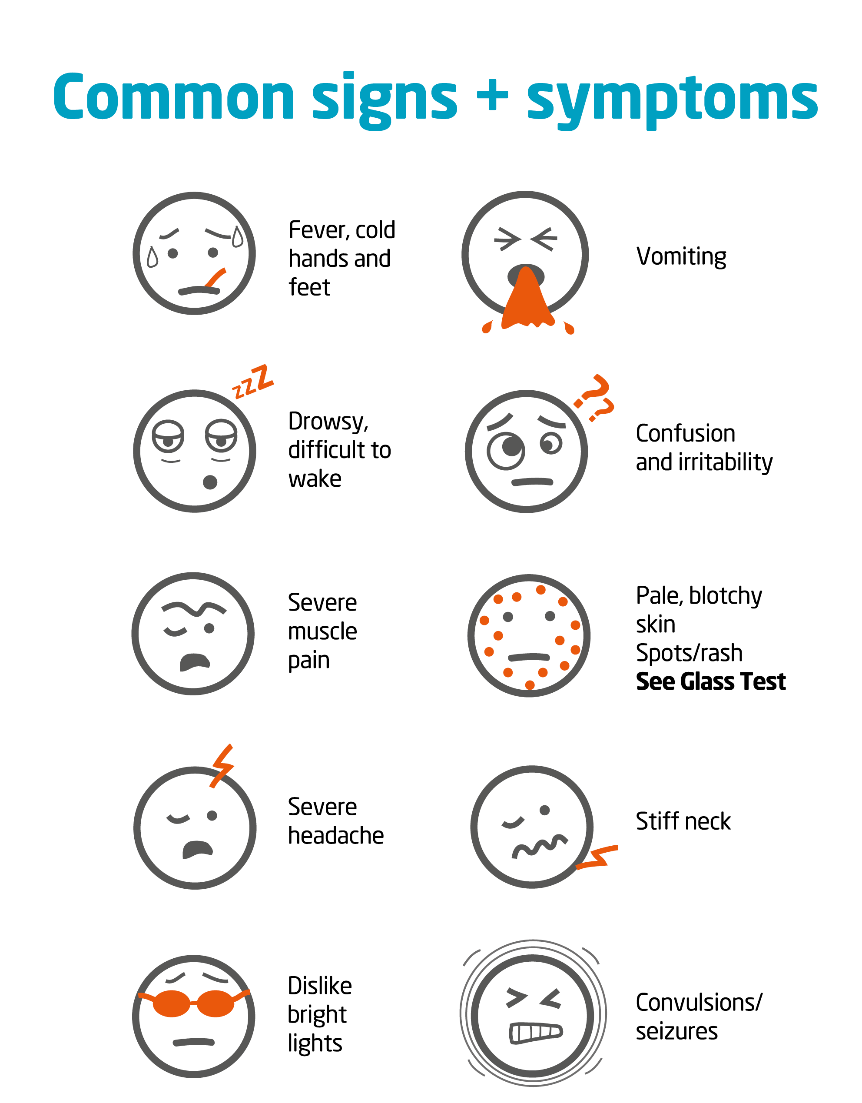
Be aware
Early symptoms can include: fever, headache, vomiting, diarrhoea, muscle pain, stomach cramps and fever with cold hands and feet
If someone is ill and getting worse, get medical help immediately

Slide 11
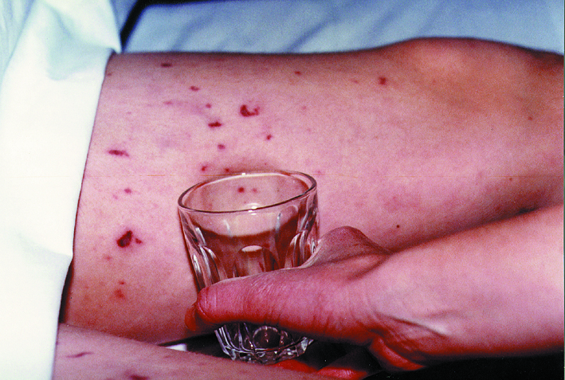
Septicaemia and the ‘glass test’
People with septicaemia may develop a rash of tiny red ‘pin pricks’ which can develop into purple bruising
This rash does not fade under pressure; do the ‘glass test’
Fever with spots/rash that do not fade under pressure is a medical emergency
Do not wait for a rash. If someone is ill and getting worse, get medical help immediately
On dark skin the spots/rash can be more difficult to see. Do not wait for the rash. Be aware of all the signs and symptoms

Slide 12
Getting medical help
If you are concerned it could be meningitis or septicaemia you can:
Call NHS 111 or your GP
In an emergency you can:
Dial 999 for an ambulance
Go to your nearest accident and emergency department
Describe the symptoms and say you think it could be meningitis or septicaemia.
Early diagnosis can be difficult. If you have had advice and are still concerned, get medical help again
Trust your instincts – get medical help immediately

Slide 13
What is the risk to others following a case in a university?
Meningitis is not highly contagious - 97% of cases happen in isolation, with no further cases occurring.
When a case occurs, the local public health team will liaise with the university to offer advice and guidance.
It is usually only those living with the person who has become ill, or their intimate kissing partners, that may have an increased risk of meningitis. The public health team will contact anyone who may have and increased risk and offer advice.
There is no reason to prevent students attending university following a case.

Slide 14
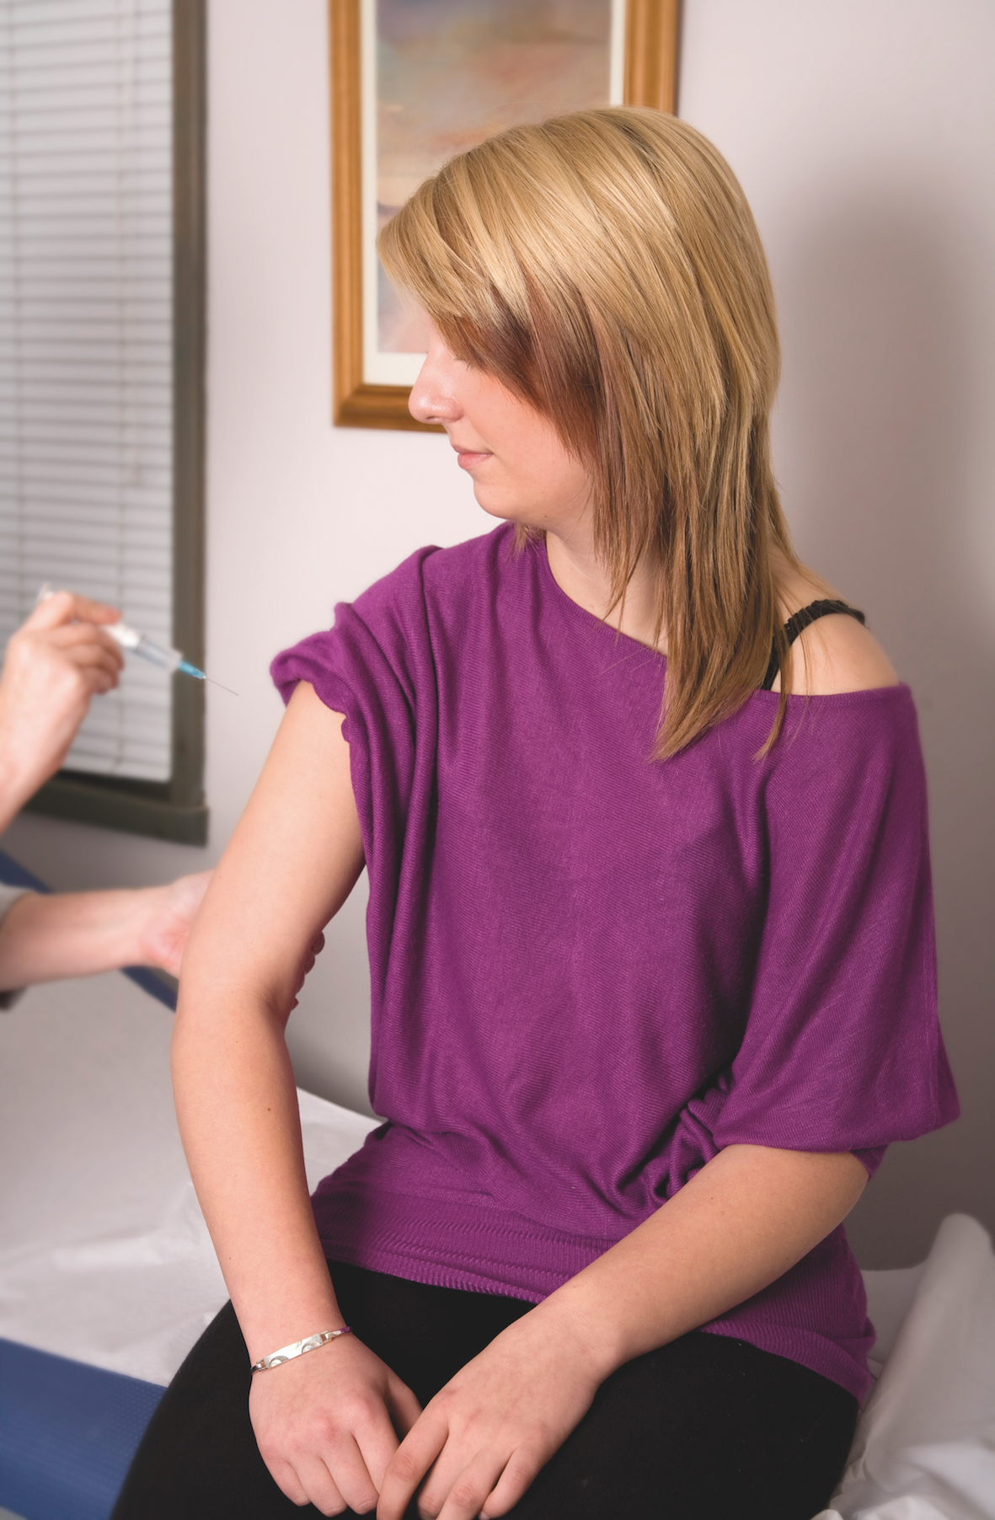
How can meningitis be prevented?
Vaccines are the only way to prevent meningitis
BUT vaccines are not available to prevent all types of meningitis
Know the signs and symptoms to look out for, and the action to take

Slide 15
Vaccines which help to protect against meningitis in students
The NHS currently recommend the MenACWY vaccine for all first year students, under the age of 25yr
The MenACWY vaccine was introduced into the routine immunisation programme following a rapid rise in cases caused by a particular harmful strain (MenW). Since 2015, the MenACWY vaccine has been offered to students around the age of 14 at school.
However, a number of students will have missed this vaccine, including overseas students. These students should be actively encouraged to seek vaccination from their GP/university health centre.
Remember, vaccines do not exist to protect against all causes of meningitis.

Slide 16
The impact of meningitis and septicaemia
Following bacterial meningitis 10% will die
It's estimated up to one person in every two or three who survives bacterial meningitis is left with one or more permanent problems
After-effects are more common following bacterial meningitis or septicaemia

Slide 17
After-effects following meningitis and septicaemia
Physical
Neurological and Emotional
Hearing loss
Sight problems
Speech problems
Limb loss, weakness or paralysis
Skin scarring/damage
Organ damage
Epilepsy
Learning and behavioural problems
Headaches
Memory and concentration issues
Emotional difficulties
Meningitis can devastate lives within hours and its impact can last a lifetime

Slide 18
Meningitis Now offers support to anyone affected by meningitis
Helpline
0808 80 10 388
Counselling
Bereavement support
Peer support
Activity weekends for young people
Community Support officers

Slide 19
Summary
Meningitis can affect anyone at any time – however students are the second most ‘at-risk’ group, after young children
Knowing the signs and symptoms and seeking urgent medical
help can help save lives
Many are left with serious and disabling after-effects that require ongoing care and support
Meningitis Now offers information, help and support to anyone affected by meningitis

